Slide 1
Module 1 – introduction to 8086

Slide 2
Introduction
8086 was the first microprocessor to be manufactured using 40 pin Dual inline Packing (DIP)
8086 is 16 bit microprocessor
Uses 5V DC supply for its operation

Slide 3
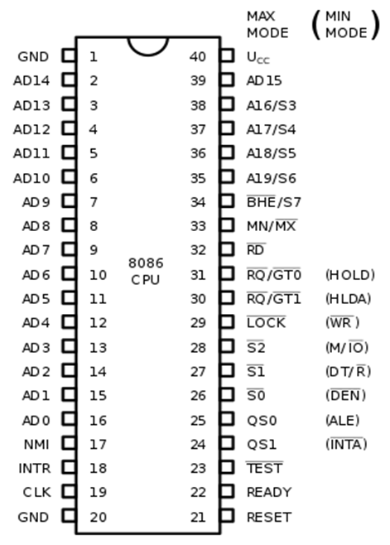
Pin diagram

Slide 4
Power supply
5V DC power supply at VCC pin 40
Ground at VSS pin 1 and 20 for operations
Clock signal
provided through pin 19
It provides timing to the processor to perform its operations
Frequency is different for different versions namely, 5MHz, 8MHz, 10 MHz.

Slide 5
Address/data buses
AD0 – AD15 → Address/Data buses
AD0 – AD7 → Carries low order byte data
AD8 – AD15 → High order byte data
During first clock cycle the bus carries 16 bit address
Later it carries 16 bit data

Slide 6
ADDRESS/STATUS BUSES
A16 – A19 → 4 address buses
S3 – S6 → 4 status buses
During first clock cycle the bus carries 4 bit address
Later it carries 4 bit data

Slide 7
S7/BHE
BHE stands for Bus High Enable
Available at pin 3
To indicate the usage of data bus D8 – D15 for transfer of data
During first cycle, the signal is low
Later it is very active

Slide 8
read
Available at pin 32
Used to read signals
ready
Available at pin 22
It is an acknowledgement signal from I/O devices that the data has been transferred.
Active high signal
High → Indicates that the device is ready to transfer
Low → Wait state

Slide 9
reset
Available at pin 21
Used to restart the execution
Makes the processor to immediately terminate its present task
Active high for first 4 clock cycles to reset the microprocessor

Slide 10
INTR
Available at pin 18
Interrupt request
The last clock cycle of every instruction is checked in order to determine whether that instruction is an interrupt or not

Slide 11
NMI
Non Maskable Interrupt
Available at pin 17
Edge triggered interrupt
Test
Like wait state
Available at pin 23
When this signal is high, the processor must wait for the IDLE state
Else, the execution is continued

Slide 12
INTA
It is an interrupt acknowledgement signal
Available at pin 33
When an interrupt is received by the microprocessor, it acknowledges the reception using this pin

Slide 13
ALE
Address Enable Latch
Available at pin 25
Whenever the processor initiates an operation, a positive pulse is generated
This indicates that there is a valid address available in the address/data bus

Slide 14
DT/R
Data Transmit/Receive
Available at pin 27
Decides the direction in which the data transfer occurs
When high → Data is transmitted
When low → Data is received

Slide 15
MI/O
This signal differentiates between memory and I/O operations
Available at pin 28
High → I/O operations
Low → Memory
WR
Write signal
Available at pin 29
Used to write data into the memory or output devices
Depends upon the status of MI/O signal

Slide 16
HLDA
Hold Acknowledgement
Available at pin 30
Acknowledges the HOLD signal
HOLD
Available at pin 31
Informs the processor that peripheral devices are requesting the usage of address/data buses

Slide 17
QS₁ and QS₀
Status signals – provides status of instruction queue
Available at pins 24 and 25
QS₀ | QS₁ | Status
0 | 0 | No operation
0 | 1 | First byte of opcode from the queue
1 | 0 | Empty the queue
1 | 1 | Subsequent byte from the queue

Slide 18
S₀, s₁, s₂
Status signals that provide the status of the operation
Used by bus controller 8288 to generate control signals and memory related signals and I/O control signals
Available at pins 26, 27 and 28
s₂ | s₁ | S₀ | Status
0 | 0 | 0 | Interrupt Acknowledgement
0 | 0 | 1 | I/O Read
0 | 1 | 0 | I/O Write
0 | 1 | 1 | Halt
1 | 0 | 0 | Opcode fetch
1 | 0 | 1 | Memory Read
1 | 1 | 0 | Memory write
1 | 1 | 1 | Passive

Slide 19
lock
Locks the CPU
Indicates the other processors not to ask for the bus from CPU
Activated by LOCK prefix in a program
Available at pin 29

Slide 20
RQ/GT₁ and RQ/GT₀
Request and grant signal to release the system bus
Once this signal is received, the CPU sends acknowledgement
RQ/GT₀ has higher priority than RQ/GT_{1.}

Slide 21
Weblinks
https://www.tutorialspoint.com/microprocessor/microprocessor_8086_pin_configuration.htm
https://www.geeksforgeeks.org/pin-diagram-8086-microprocessor/

